Slide 1
Satisfied Smiles
Royal Hackaway v6

Slide 2
Agenda
Introduction
Primary goals
Project Implementation
Summary

Slide 3
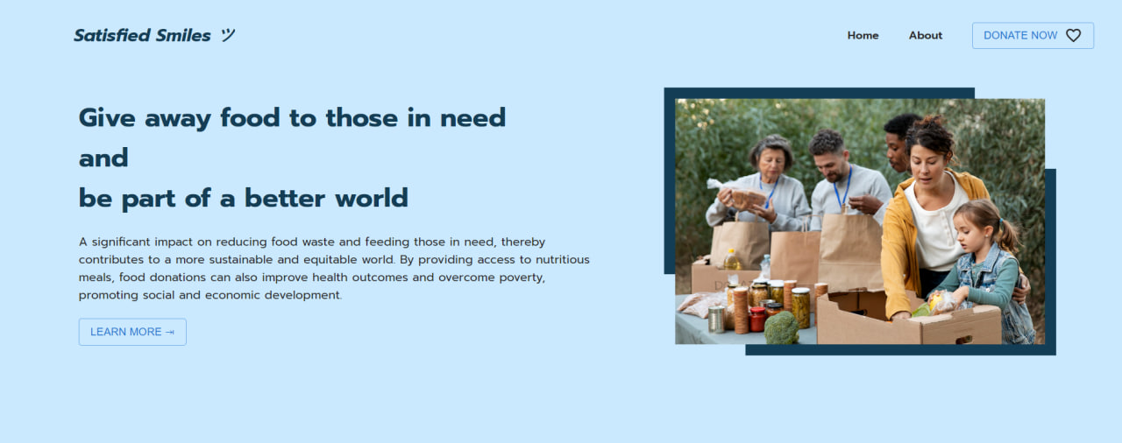
Introduction
Satisfied Smiles – a website that helps give away food to those in need.
Easier to donate surplus or unsold food, our web helps reduce food waste and nourish communities in need.
Built with a user-friendly and modern interface for users.

Slide 4
Primary goals

Slide 5
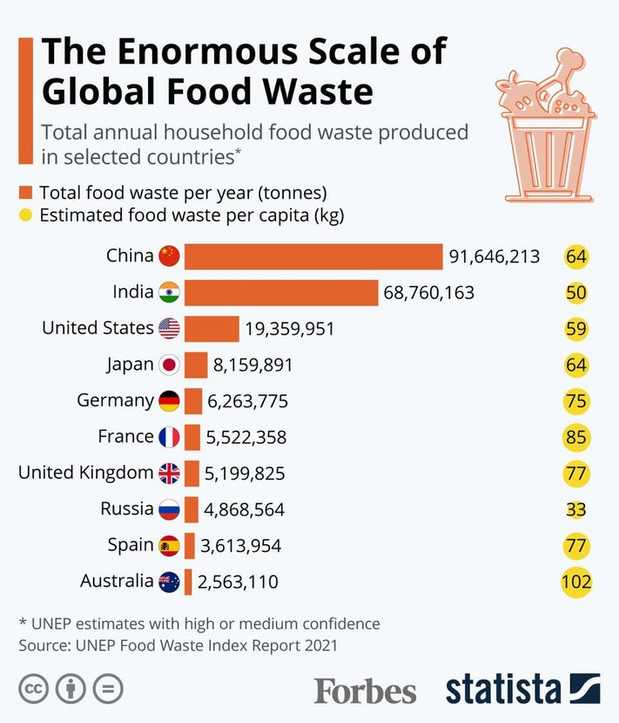
How much food is wasted?
2.5 billion tonnes of food is wasted every year across the world
Which makes it a 40% of food we consume
Where are food being wasted hugely? Restaurants, Individual Households

Slide 6
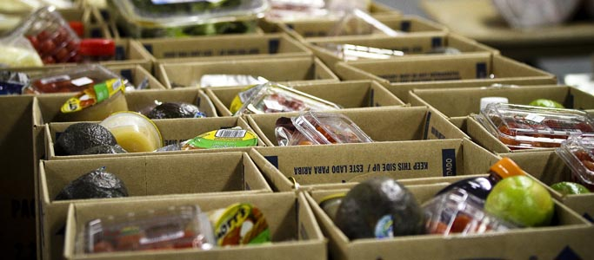
How can we solve this?
With rapid growth in technology, a sustainable project can be implemented.
By providing access to nutritious meals to the needy, food donations can also improve health outcomes and overcome poverty, promoting social and economic development.
And we can tremendously decrease food waste.
Area of focus: leftover cooked meals of the day from restaurants, food products from households

Slide 7
Reducing food waste and nourishing communities in need.
“
”
Satisfied Smiles

Slide 8






Project Implementation
Techs used
Domains
Deployed on Netlify using the domain from Domain.com (www.satisfiedsmiles.tech)

Slide 9
Summary
We believe that contributing at least one meal away and giving away edible food that we plan to waste can bring a great impact.
Future Goals: Adding backend service with NodeJS and Firebase - Sign Up, Login Authentication Features. Google dialogue flow chatbot integrated with Twilio.

Slide 10
Thank you
Anushadevi Rajkumar
Thaarik Ahamed Ahemed Ali
Queen Mary, University of London

